Slide 1
Distributed Network Programming
Dilip Kumar Shrestha

Slide 2
Overview
Introduction
The API for the Internet Protocol
External data representation and marshalling
Client server communication
Group communication

Slide 3
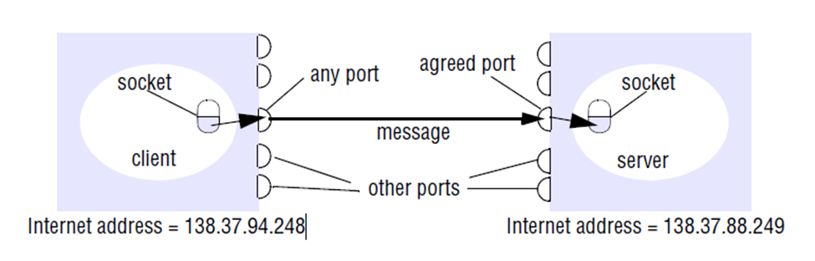
The API for the Internet Protocol
UDP
TCP

Slide 4
Issues
Datagram
Stream
Packet size
Blocking
Timeouts
Receive from any
Failure model
Omission Failure
Ordering
Message size
Lost message
Flow control
Message duplication and ordering
Message destinations
Outstanding issues
Matching of data item(data format)
Blocking
Threads
Failure Model
Ideal protocol

Slide 5
Usages
Datagram
Stream
DNS
VOIP
HTTP
FTP
Telnet
SMTP

Slide 6
COBRA’s Common Data Representation(CDR)
Primitive Types
Composite/Constructed Types
Type | Size(bit)
Short | 16
Long | 32
Unsigned short | 16
Unsigned long | 32
Float | 32
Double | 64
Char | 1
Boolean | 1
Octet | 8
Type | Representation
Sequence | Length(unsigned long) followed by elements in order
String | Length(unsigned long) followed by characters in order
Array | Array elements in order(fixed length)
Struct | In the order of declaration of the components
Enumerated | Unsigned long(the values are specified by the order of declaration)
Union | Type tag followed by the selected member

Slide 7
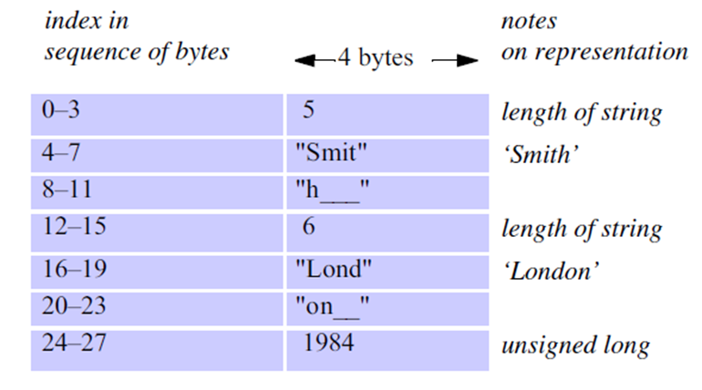
Example
struct Person{
string name;
string place;
unsigned long year;
};
Let us consider Person struct with value:
{‘Smith’, ‘London’, 1984}.

Slide 8

Remote Object Reference
A remote object reference is an identifier for a remote object that is valid throughout a distributed system. A remote object reference is passed in the invocation message to specify which object is to be invoked.
Internet Address | Port number | Time | Object number | Interface of remote object
32 bits | 32 bits | 32 bits | 32 bits

Slide 9
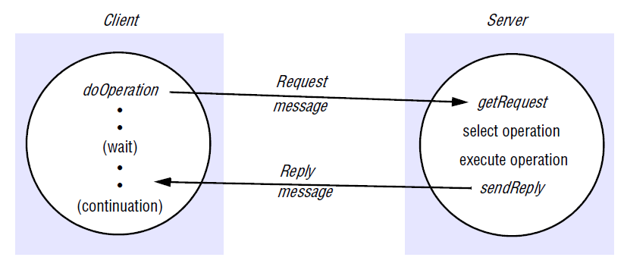
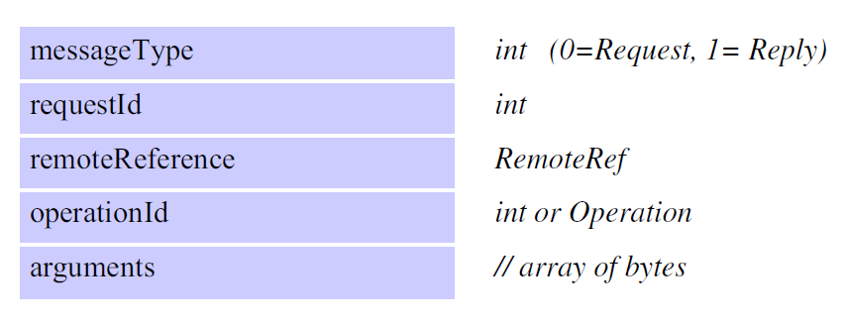
Client Server Communication
Request-Reply protocol primitives
Request-reply message structure

Slide 10
Communication Between Distributed Objects
Object Model
Remote Object Model
Object reference
Interface
Actions
Exception
Garbage collection
Remote Object reference
Remote Interface
Actions
Exception
Garbage collection

Slide 11
Remote Method Invocation
Design Issues
RMI Invocation Semantics
Maybe
At-least-once
At-most-once
Transparency
Syntax and semantics
Latency
Exception

Slide 12
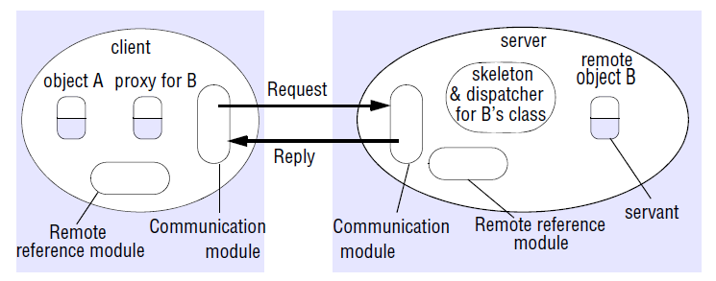
RMI Implementation

Slide 13
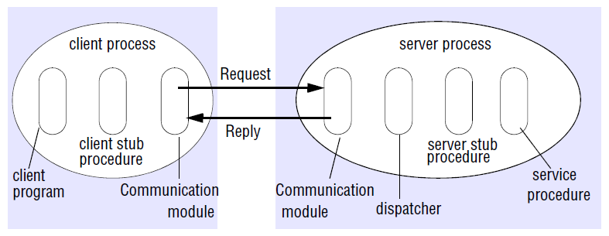
RPC Implementations

Slide 14
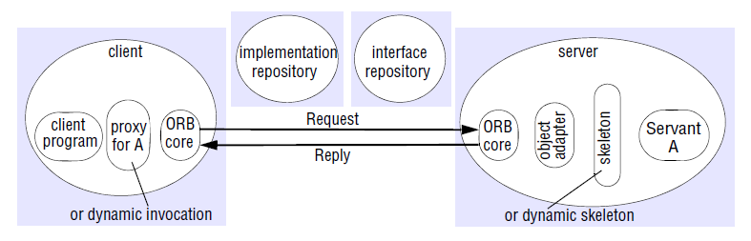
Corba Implementation

